Slide 1

By
Saba Bukhari

Slide 2
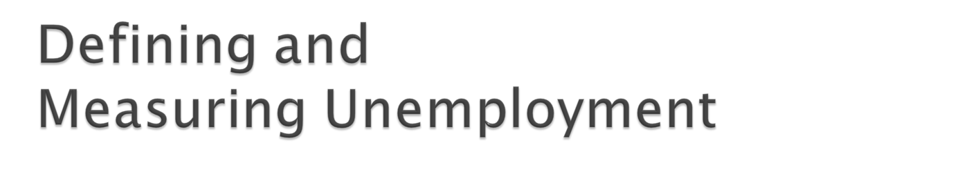
The most frequently discussed symptom of a recession is unemployment.
An employed person is any person of 16 years old or above:
  who works for pay, either for someone else or in his or her own business for 1 or more hours per week,
  who works without pay for 15 or more hours per week in a family enterprise, or
  who has a job but has been temporarily absent, with or without pay.
Notes:
The Labor force is the employed plus the unemployed

Slide 3
An unemployed person is a person 16 years old or above:
  is not working,
  is available for work, and
  has made specific efforts to find work during the previous 4 weeks.

Slide 4

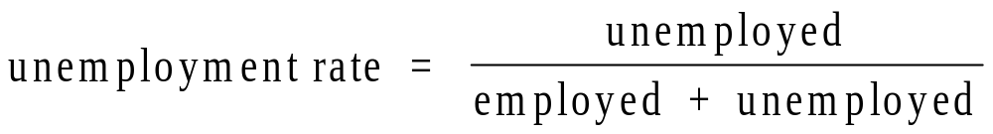
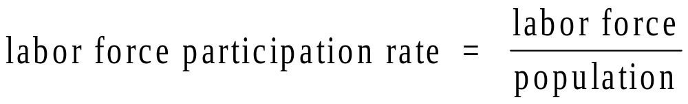

Slide 5
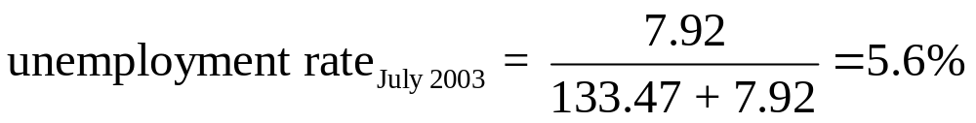
Computing the unemployment rate for the month of July 2003:
  Labor force: 141.39 million
  Employed: 133.47 million
  Unemployed: 7.92 million

Slide 6

Frictional unemployment
Frictional unemployment arises because of the time needed to match qualified job seekers with available job openings
    New college grads looking for jobs
    Parents returning to the work force
    Quit job to look for a better one

Slide 7
Structural unemployment is the portion of unemployment that is due to changes in the structure of the economy that result in a significant loss of jobs in certain industries.
Technology (machines) displaces workers
International Trade (workers lose jobs due to trade)
Cyclical unemployment is the increase in unemployment that occurs during recessions and depressions.
Seasonal unemployment is caused by seasonal shifts in labor supply and demand
  Examples: construction, agriculture, Life Guards

Slide 8
Inflation is an increase in the overall price level.
Deflation is a decrease in the overall price level.
A recession is roughly a period in which real GDP declines for at least two consecutive quarters. It is marked by falling output and rising unemployment
A depression is a prolonged and deep recession..
In recession unemployment increases

Slide 9

Recessions may help to reduce inflation.
Some argue that recessions may increase efficiency by driving the least efficient firms out of business and by forcing surviving firms to trim waste and manage their resources better.
Also, a recession leads to a decrease in the demand for imports, which improves a nation’s balance of payments.

Slide 10

Defined by economist Arthur Okun in 1962.
Describes the inverse relationship between unemployment and GDP growth.
For every 1% increase in unemployment, a country's GDP falls by approximately 2%–3% from its potential.
It suggests that when the unemployment rate decreases, a nation's GDP grows at a faster rate, and vice versa.

Slide 11

Inflation is an increase in the overall price level.
Deflation is a decrease in the overall price level.
Sustained inflation is an increase in the overall price level that continues over a significant period.

Slide 12
Inflation is a sustained increase in the average level of prices
Hyperinflation is a very high rate of inflation
  Brazil experienced inflation over 1000% during some recent years
  Germany between WW1 and WW2
Disinflation is a reduction in the positive inflation rate

Slide 13
Recessions may help to reduce inflation.
Some argue that recessions may increase efficiency by driving the least efficient firms out of business and by forcing surviving firms to trim waste and manage their resources better.
Also, a recession leads to a decrease in the demand for imports, which improves a nation’s balance of payments.

Slide 14
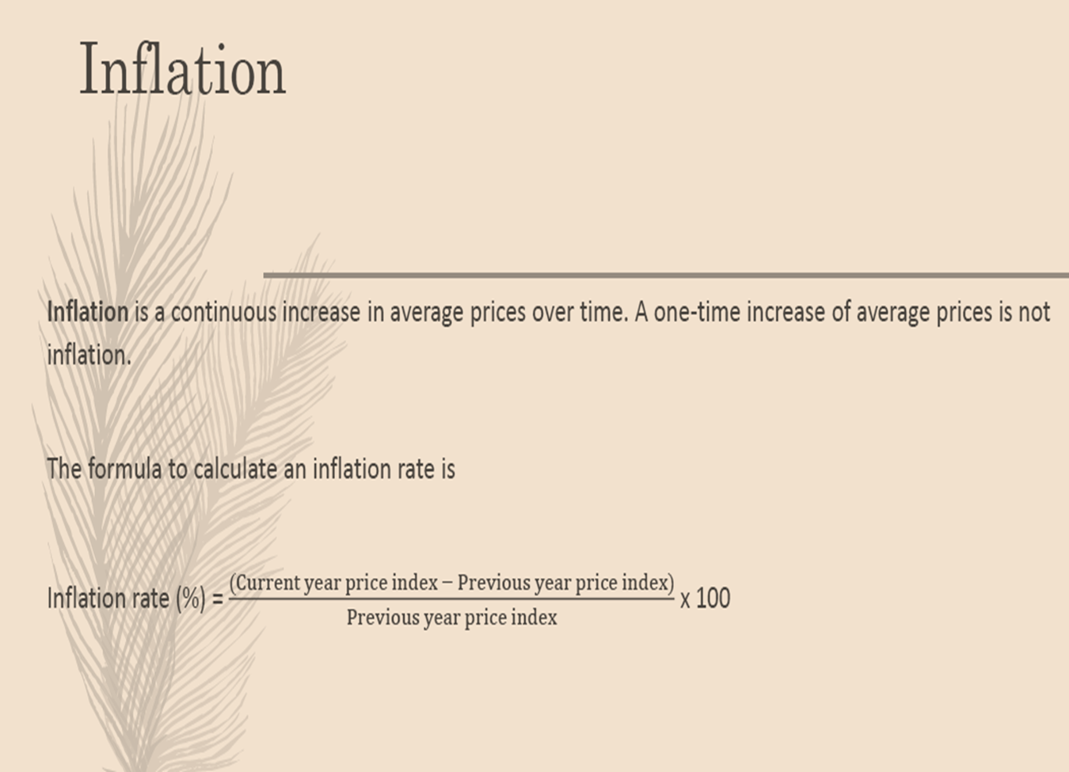

Slide 15

Consumer Price Index
Producer Price Index
GDP Deflator

Slide 16
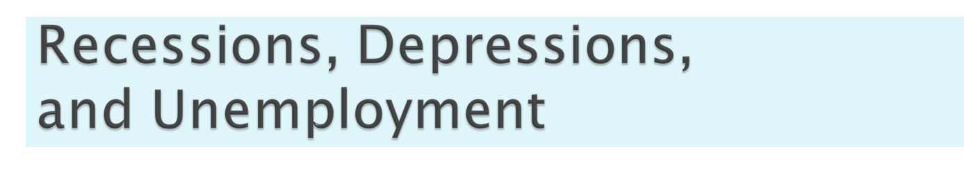
The business cycle describes the periodic ups and downs in the economy, or deviations of output and employment away from the long-run trend.
A recession is roughly a period in which real GDP declines for at least two consecutive quarters. It is marked by falling output and rising unemployment
A depression is a prolonged and deep recession..
In recession unemployment increases

Slide 17

Types of Inflation
  Demand-Pull Inflation
    Total spending in excess of production capacity
    Often described: “too many dollars chasing too few goods”
    Demand curve shifting to the right

Slide 18

Types of Inflation (continued)
  Cost-Push Inflation (Supply-Side Inflation)
    Cost-push Inflation summarized:
      Prices rise due to rising production costs (factors of production) called “supply shocks” (oil, wages, other materials)
      Supply curve “shifts to the left”

